Slide 1

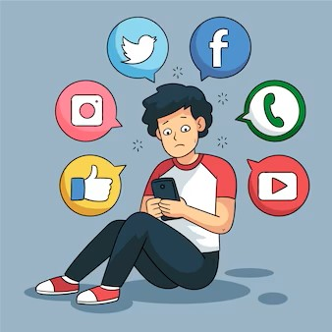

Presentation 2023
Discover The Mental Health Status Using Social Media Behavioral Patterns
24-25J-106

Slide 2

Content
01
Introduction
02
Problem Statement
03
Research Gap
04
Objectives
05
High-Level Diagram
06
Individual Components
07
Commercialization Plan
08
Data Set

Slide 3


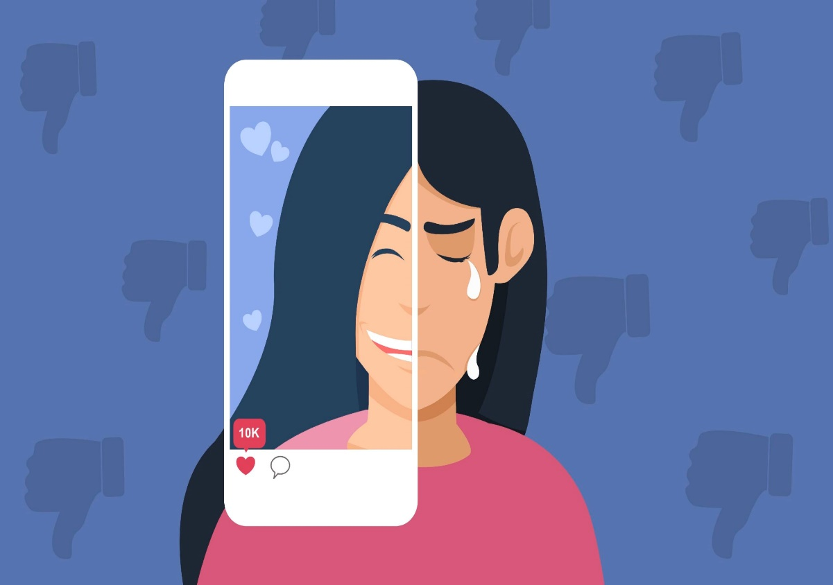
INTRODUCTION
Topic: Discover The Mental Health Status Using Social Media Behavioral Patterns
Research group: Centre of Excellence for AI (CEAI)
Research area: Bio-Medical and Health Informatics (HI)
This research uses image processing and content analysis of social media behavior to assess mental health, aiming for early intervention and support by analyzing emotional responses, usage patterns, and demographics.

Slide 4



Problem Statement
Nowadays, many people, especially the youth, lead highly stressful lives. Their real mental state often goes unnoticed as they hide behind the facade of social media. This research aims to track and analyze user behaviors on social media to uncover their true mental health status.

Slide 5

Research Gap
Comprehensive Data Integration
Real-time Emotional Analysis
Environment and Context Consideration
Demographic-Specific Insights
Predictive and Preventive Models

Slide 6
Objectives
1
Short-term Mental Status Identification
2
Long-term Mental Status Tracking
3
Usage Pattern and Context Analysis
4
Demographic Correlation
5
Comprehensive Data Model Development
6
Early Intervention and Personalized Support

Slide 7
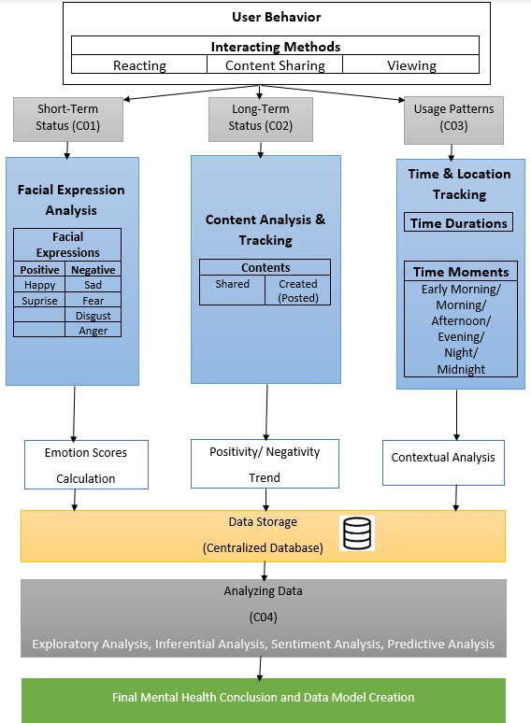

Slide 8

Individual Components

Slide 9
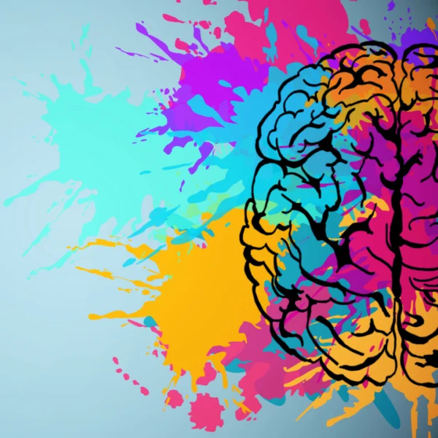


Amarasinghe R.A.D.T.
Image Processing
01
Identify the short-term mental status
Facial Expression Analysis

Slide 10
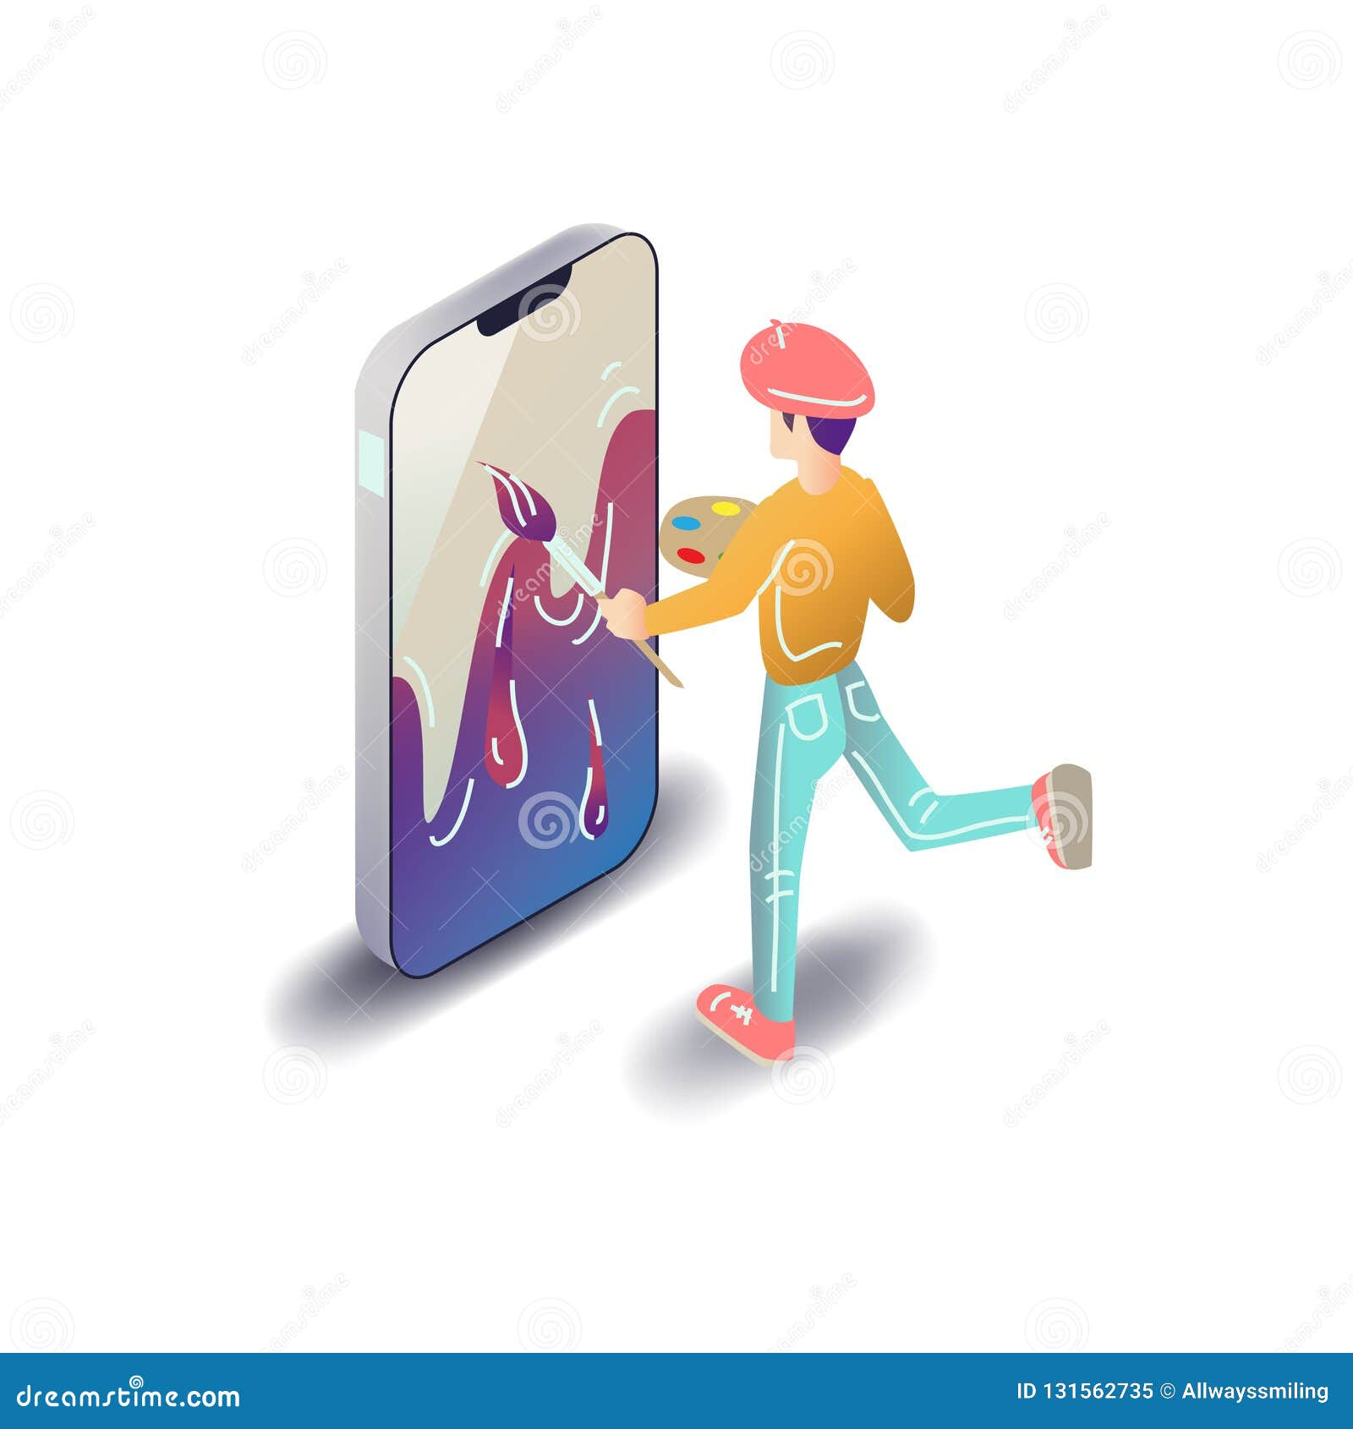



Ekanayaka E.M.C.S.
Natural language processing
02
Image Processing
Identify the long-term mental status
Content Analyzing

Slide 11



Nanayakkara A.A.R.
Time & Location Tracking
03
Track times and durations that user spends on the platform
Time Durations

Slide 12



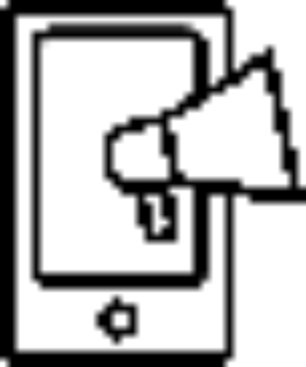

Senadheera W.D.N.D.
Analyzing Data
Qualitative analysis
04
Analyze all databases and train a model
Quantitative analysis
Suggest solutions
Develop a data model

Slide 13

Commercialization Plan
We are planning to release 2 versions.
1) Initial version
It includes qualitative analysis and less quantitative analysis.
2) Advanced qualitative analysis

Slide 14
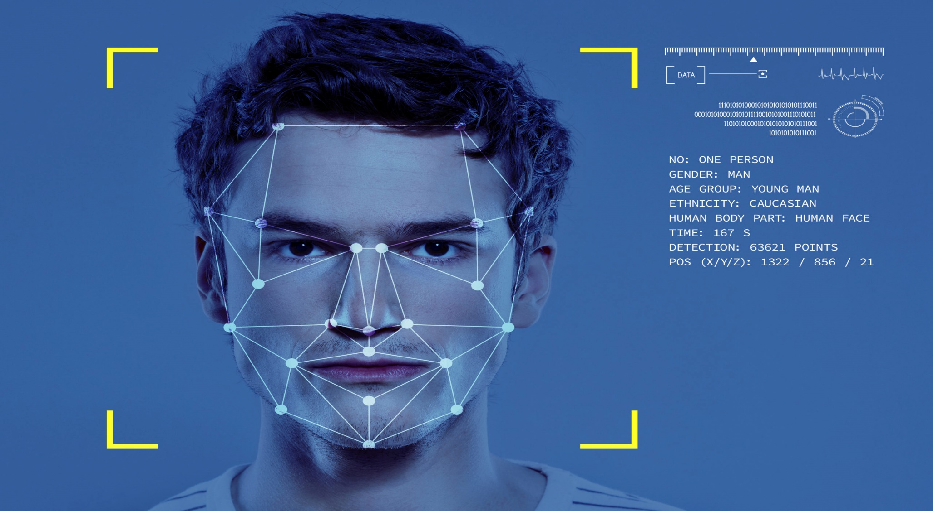
Data Sets
Facial key point detection:
facial keypoint detection (kaggle.com)

Slide 15


Our Team
Student Name | IT Number | Functions
Amarasinghe R.A.D.T. | IT21292118 | Identify the short-term mental status
Ekanayaka E.M.C.S. | IT21371790 | Identify the long-term mental status
Nanayakkara A.A.R. | IT21700156 | Track times and durations that user spends on the platform
Senadheera W.D.N.D. | IT21220388 | Analyze all databases and train a model
Remy
Marsh

Slide 16

THANK YOU!

